Slide 1

WDS WFH
Common Troubleshooting Steps!

Slide 2
Table of Contents
Thin Client
  Extreme Slowness/Freezing for Thin client/AWS
  CPU Usage over 90%
  Unable to log into thin client
  Incorrect Time Zone
  Thin Client Monitor or display errors
Hard Phone
  Showing wrong phone number at top left URGENT this means Mask isn’t properly set
  Calls not being recorded while using hard phone
  Hard phone stuck on “Registering”
  Verify Service Domain & internet connectivity
  Phone Stuck on Connecting Screen
  Invalid Username/Password
  HTTP error 502
  Phone Cycles through Registering

Slide 3
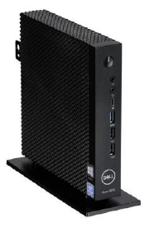
AWS THIN CLIENT
The following Slides will help with troubleshooting steps for common WDS work from home issues.

Slide 4

Extreme Slowness or Even Freezing for Thin Client/AWS
Open a thread and @ the agent inside the channel #caretech-hardphone-support with a quick description of what's going on
Then have the agent follow the 3 steps below
Open your task manager, sort by CPU usage where highest is at top and take a screenshot then post it as a reply in your support thread
Go to speedtest.net and post a screenshot of your results as a reply in your support thread
From a different device ON YOUR NETWORK please go to https://clients.amazonworkspaces.com/Health.html and post a screenshot of the results as a reply in your support thread
Once all 3 are posted as a reply to their thread do a @ for Jason McPeek & Stephen Hastings and they will receive support

Slide 5

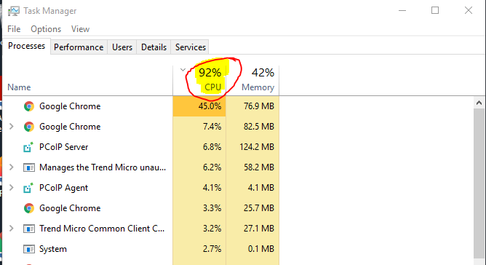
CPU Usage over 90%!
When your system is operating so slowly you cannot function. Check your Task Manager to see the CPU Usage if its steadily over 90% you likely have this issue.
Open a Thread in
#caretech-hardphone-support
with a quick description of what’s
going on and post a Screenshot of
your Task Manager as seen→ → →
@ Jason Mcpeek & Stephen Hastings

Slide 6

Unable to Log In to Your Thin Client
Error: “Unable to log in as you are already logged in elsewhere”
It is possible you may need to have your AWS instance rebooted by admins, please open a thread in #caretech-hardphone-support
Give a short description of your concern then @ Stephen Hastings & Jason McPeek so they can review

Slide 7
Incorrect Time-Zone
Please contact Get Help x.co/gethelp and post the request “AWS TimeZone” and they will fix you up. This is fast should take only a couple minutes.
This is a known concern that will keep coming back whenever there is an update. We are working towards a permanent solution however all agents will need to repeat this each time an update is put out until further notice.

Slide 8
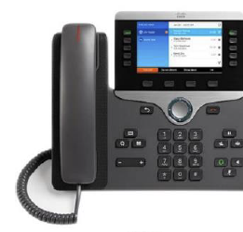
HARD-PHONE Support Issues
The Following Section is a Guide for Common Troubleshooting Steps When Using Your New Cisco Hard-Phone

Slide 9
Hardphone Showing Incorrect Phone Number
At Top Left Corner
Go to the Slack Channel #caretech-hardphone-mac
Post this message “Please change my phone mask to 480-366-3336 between 06:00AM and 06:30PM"

Slide 10
Calls Not Being Recorded After Switching to Hard Phones
Please fill out the report on this link below and telecom will research and respond.
https://godaddy.service-now.com/gdsp?id=gd_sc_cat_item&sys_id=63c4025c37147a44ce4fb15ec3990e98

Slide 11
Hard-phone is stuck on "Registering"
1st Try the steps in slide 12 for “Reset Service Mode”
If that does not Work
Unplug the ethernet cable from the phone. Do a full reset on it.
Reset the Gateway. Verify the device is not showing as connected from the Router login page.
With the power off on the phone plug it in to the router and power the phone on.
If this doesn’t work open a thread in #caretech-hardphone-support and @ Spencer Hunter & Bryce Elam

Slide 12
After Resetting Jomax Password for Okta, Hard-phone No Longer Accepts New Password
Try entering a fake username/pwd (anything) – then try your real one again. If this does not work proceed to next step.
Unplug hard phone for 90 seconds, plug back in and follow steps for “Reset Service Mode” in Slide # 12
If this doesn’t work open a thread in #caretech-hardphone-support and @ Spencer Hunter & Bryce Elam

Slide 13
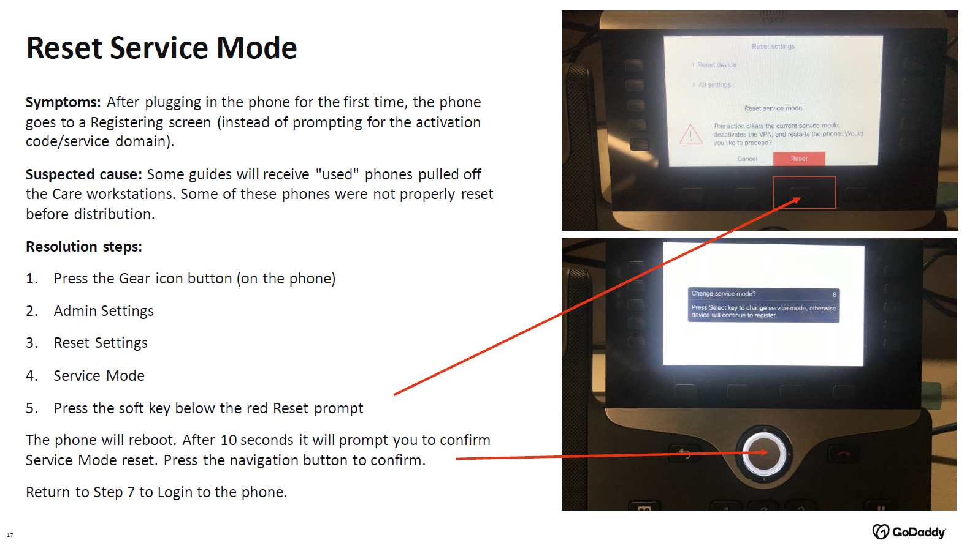

Slide 14
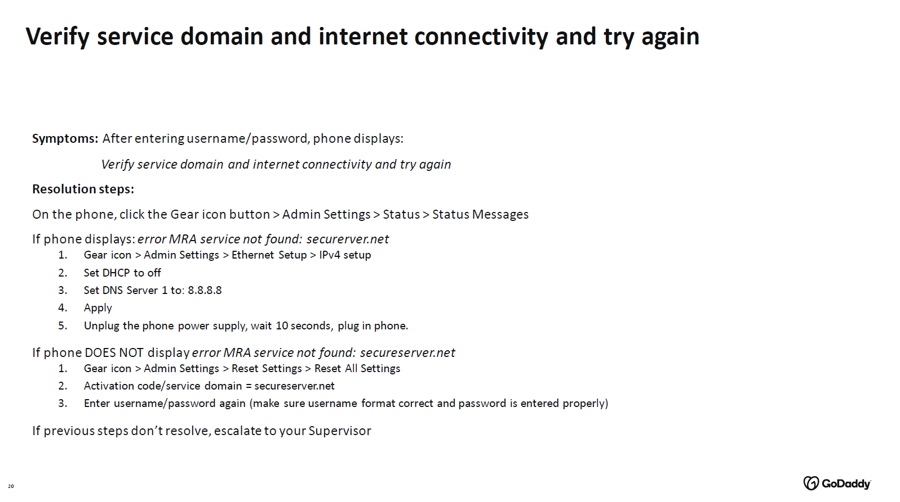

Slide 15
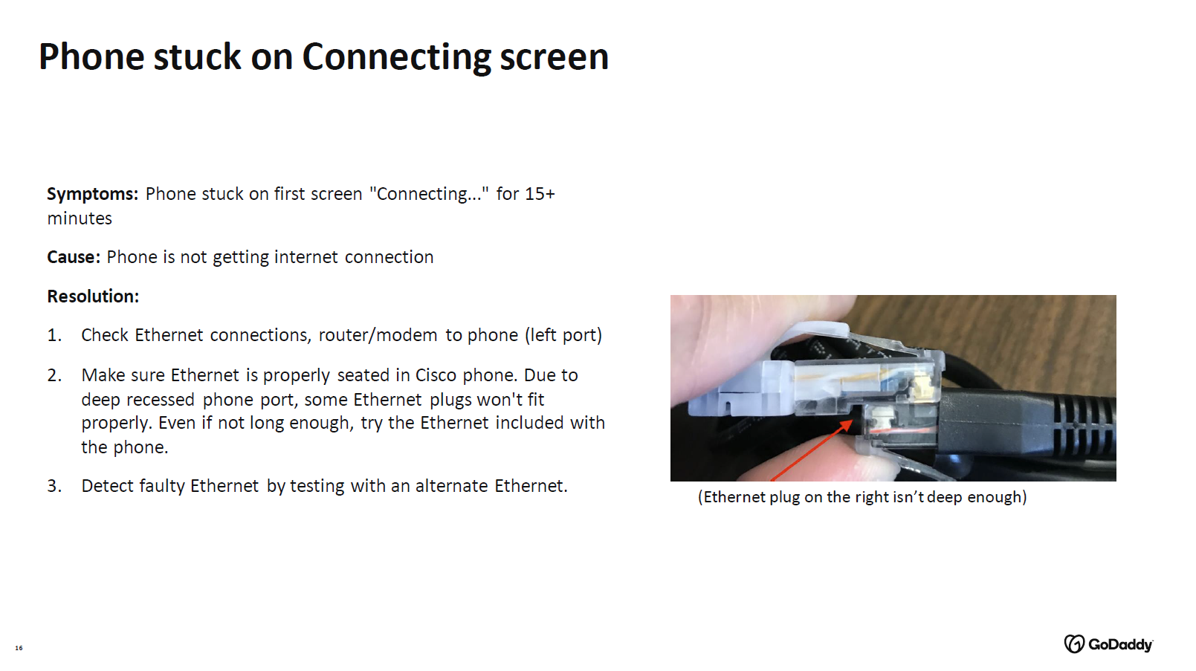

Slide 16
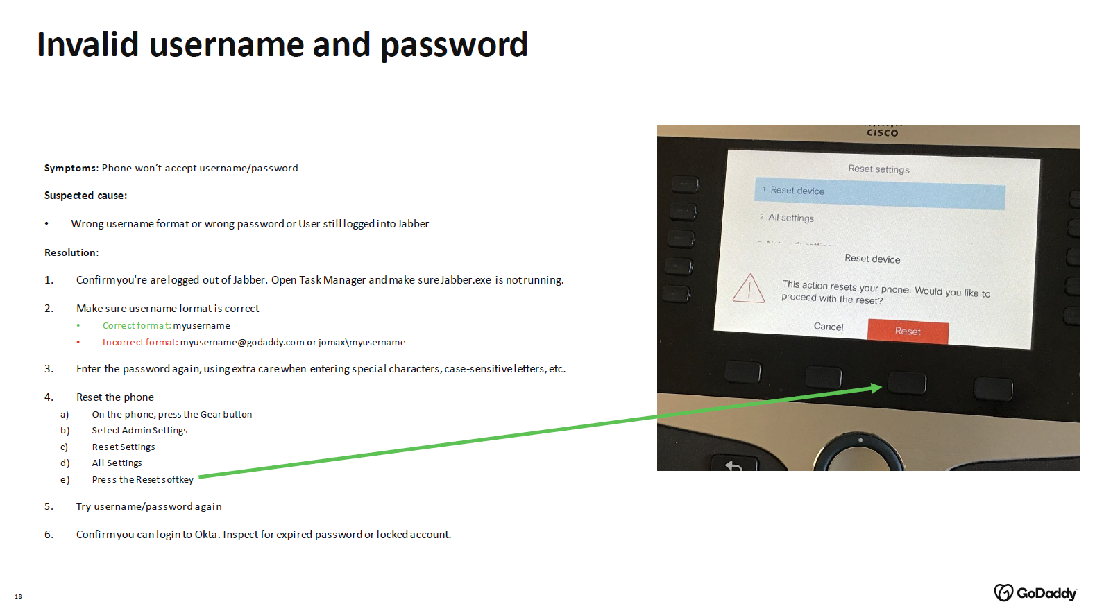

Slide 17
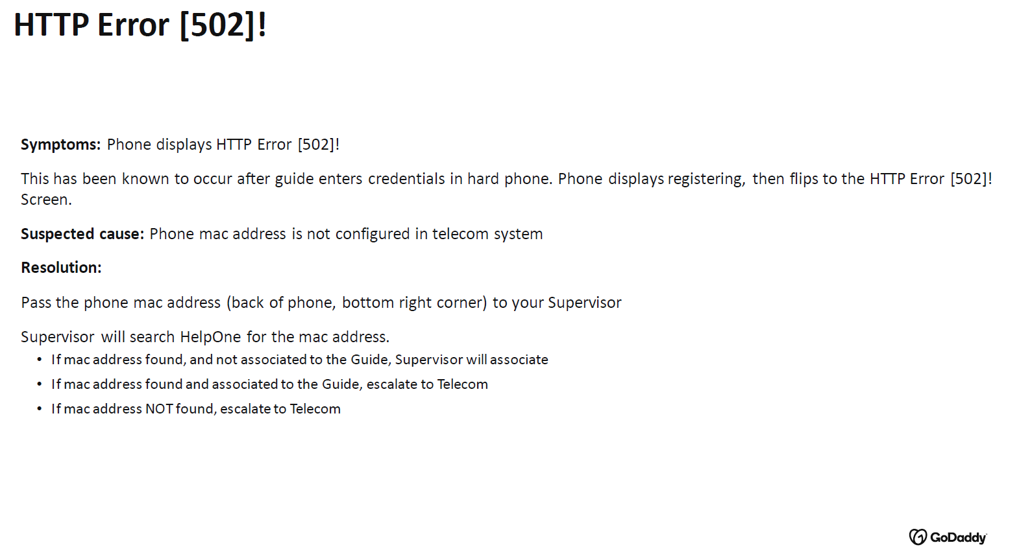

Slide 18
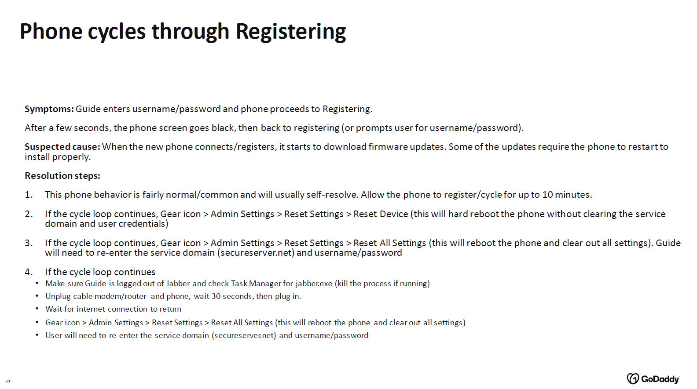

Slide 19
